Slide 1
Indici di similarità autoencoder 1

Slide 2
AUTOENCODER 1)
def decoder(output_shape):
inputs = Input(shape=output_shape)
x = Dense(2*2*256, activation='relu')(inputs)
x = Reshape((2, 2, 256))(x)
x = Conv2D(256, (3, 3), activation='relu', padding='same')(x)
x = UpSampling2D((2, 2))(x)
x = Conv2D(128, (3, 3), activation='relu', padding='same')(x)
x = UpSampling2D((2, 2))(x)
x = Conv2D(64, (3, 3), activation='relu', padding='same')(x)
x = UpSampling2D((2, 2))(x)
x = Conv2D(32, (3, 3), activation='relu', padding='same')(x)
x = UpSampling2D((2, 2))(x)
x = Conv2D(16, (3, 3), activation='relu', padding='same')(x)
x = UpSampling2D((2, 2))(x)
x = Conv2D(8, (3, 3), activation='relu', padding='same')(x)
#x = UpSampling2D((2, 2))(x)
#x = Conv2D(128, (3, 3), activation='relu', padding='same')(x)
#x = Conv2D(128, (3, 3), activation='relu', padding='same')(x)
#x = UpSampling2D((2, 2))(x)
decoded = Conv2D(1, (3, 3), activation='sigmoid', padding='same')(x)
decoder_model = Model(inputs, decoded, name='decoder')
decoder_model.summary()
return decoder_model
def encoder(input_shape):
inputs = Input(shape=input_shape)
x = Conv2D(8, (3, 3), activation='relu', padding='same')(inputs)
x = MaxPooling2D((2, 2), padding='same')(x)
x = Conv2D(16, (3, 3), activation='relu', padding='same')(x)
x = MaxPooling2D((2, 2), padding='same')(x)
x = Conv2D(32, (3, 3), activation='relu', padding='same')(x)
x = MaxPooling2D((2, 2), padding='same')(x)
x = Conv2D(64, (3, 3), activation='relu', padding='same')(x)
x = MaxPooling2D((2, 2), padding='same')(x)
x = Conv2D(128, (3, 3), activation='relu', padding='same')(x)
x = MaxPooling2D((2, 2), padding='same')(x)
x = Conv2D(256, (3, 3), activation='relu', padding='same')(x)
x = GlobalAveragePooling2D()(x) # Global Average Pooling
x = Flatten()(x)
encoded = Dense(64, activation='relu', kernel_regularizer=l1(10e-8))(x)
encoder_model = Model(inputs, encoded, name='encoder')
encoder_model.summary()
return encoder_model
autoencoder_model1.compile(optimizer=AdamW(learning_rate=learning_rate), loss='binary_crossentropy')

Slide 3
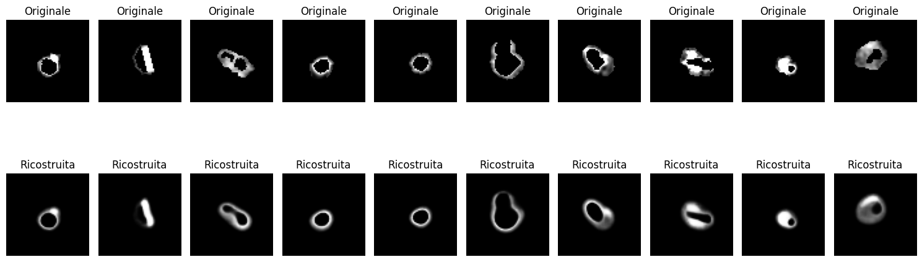
Mean SSIM: 0.584817948322206 and Mean SSIM with mask: 0.945132102357646
Mean Cosine Similarity: 0.9069598973957775 and Mean Cosine Similarity with mask: 0.9386798065703272
Mean MSE: 0.003728248652865048
Mean PSNR: 25.216685043802304
Mean NRMSE: 0.05855753335974087
Mean Manhattan Distance: 49.28105926513672
Mean Euclidean Distance: 3.7072818279266357
For the autoncoder of 64 features

Slide 4
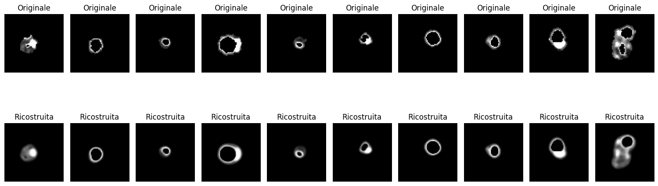
Mean SSIM: 0.5858644836265667 and Mean SSIM with mask: 0.9452289090498508 Mean Cosine Similarity: 0.9072279712565322 and Mean Cosine Similarity with mask: 0.9390132707567338
Mean MSE: 0.0037225481272313036 Mean PSNR: 25.228558582668406 Mean NRMSE: 0.058491410872306186 Mean Manhattan Distance: 48.99696350097656 Mean Euclidean Distance: 3.7034523487091064
For the autoncoder of 128 features

Slide 5
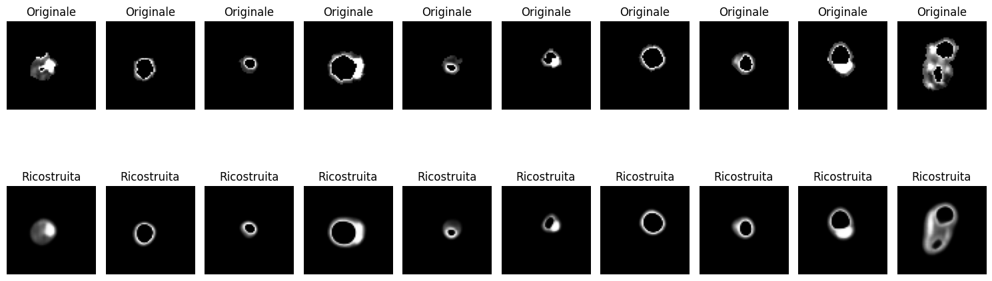
Mean SSIM: 0.5703736938755214 and Mean SSIM with mask: 0.9424368346961823 Mean Cosine Similarity: 0.9019171301004772 and Mean Cosine Similarity with mask: 0.9351964531725735 Mean MSE: 0.003934988605115005 Mean PSNR: 25.006916230880627 Mean NRMSE: 0.060085845115926614 Mean Manhattan Distance: 50.94544982910156 Mean Euclidean Distance: 3.8044207096099854
For the autoncoder of 32 features

Slide 6
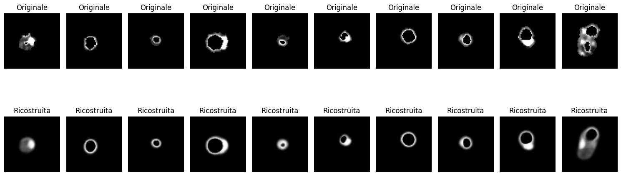
Mean SSIM: 0.45572523110167446 and Mean SSIM with mask: 0.9208674743512494
Mean Cosine Similarity: 0.8612912373249413 and Mean Cosine Similarity with mask: 0.908492686702798
Mean MSE: 0.005526157333807097
Mean PSNR: 23.537774121233202
Mean NRMSE: 0.07119736030464706
Mean Manhattan Distance: 66.24838256835938
Mean Euclidean Distance: 4.5094804763793945
For the autoncoder of 16 features

Slide 7
Autoencoder 2
## MODELLO PIU SEMPLICE (CON MENO PARAMETRI)
def encoder(input_shape):
inputs = Input(shape=input_shape)
x = Conv2D(8, (3, 3), activation='relu', padding='same')(inputs)
x = BatchNormalization()(x)
x = MaxPooling2D((2, 2), padding='same')(x)
x = Conv2D(16, (3, 3), activation='relu', padding='same')(x)
x = BatchNormalization()(x)
x = MaxPooling2D((2, 2), padding='same')(x)
x = MaxPooling2D((2, 2), padding='same')(x)
x = GlobalAveragePooling2D()(x)
encoded = Dense(32, activation='relu', kernel_regularizer=l1(10e-8))(x)
encoder_model = Model(inputs, encoded, name='encoder')
encoder_model.summary()
return encoder_model
def decoder(output_shape):
inputs = Input(shape=output_shape)
x = Dense(8 * 8 * 32, activation='relu')(inputs)
x = Reshape((8, 8, 32))(x)
x = UpSampling2D((2, 2))(x)
x = UpSampling2D((2, 2))(x)
x = Conv2D(16, (3, 3), activation='relu', padding='same')(x)
x = BatchNormalization()(x)
x = UpSampling2D((2, 2))(x)
x = Conv2D(8, (3, 3), activation='relu', padding='same')(x)
x = BatchNormalization()(x)
decoded = Conv2D(1, (3, 3), activation='sigmoid', padding='same')(x)
decoder_model = Model(inputs, decoded, name='decoder')
decoder_model.summary()
return decoder_model
autoencoder_model.compile(optimizer=AdamW(learning_rate=learning_rate), loss='binary_crossentropy')

Slide 8
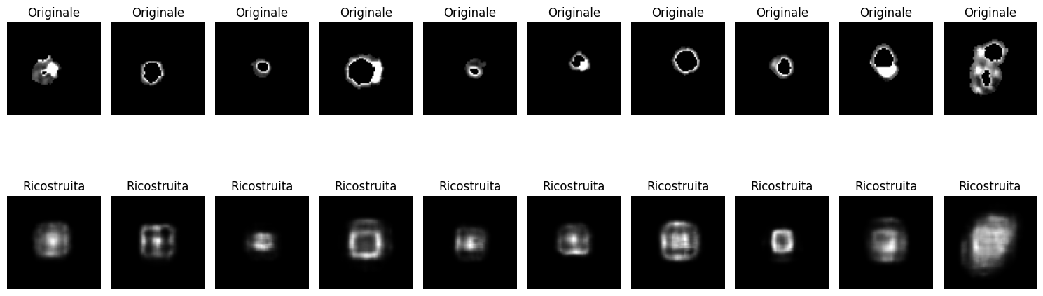
Indici di similarità autoencoder 2 (32 features)
Mean SSIM: 0.10989702731490039 and Mean SSIM with mask: 0.7106462315791838 Mean Cosine Similarity: 0.5619306006664121 and Mean Cosine Similarity with mask: 0.8183649094028767 Mean MSE: 0.015162331211169083 Mean PSNR: 19.00053684880047 Mean NRMSE: 0.11886658286581134 Mean Manhattan Distance: 161.06944274902344 Mean Euclidean Distance: 7.53603458404541

Slide 9
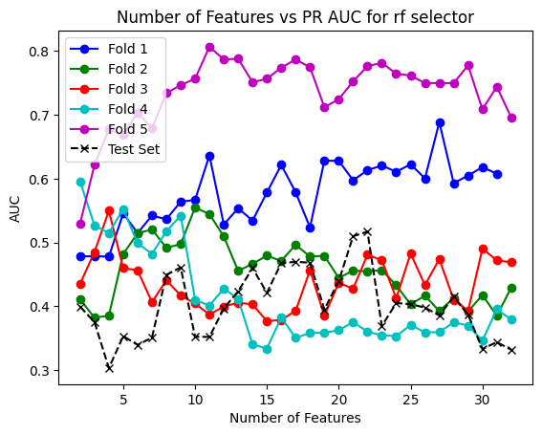
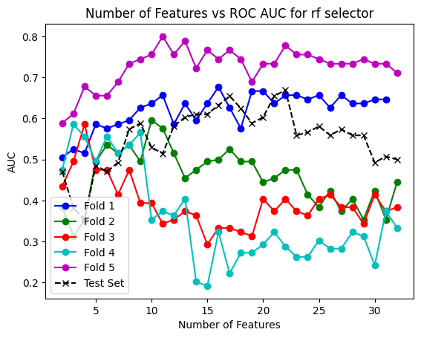
Risultati autoencoder 2 cross validation RF
Results obtained with the best mean parameters on the test set for rf and rf classifier Features: 12.6 threshold: 0.442 F1 score: 0.5 best_precision: 0.375 best_recall: 0.75
confusion matrix : [[ 7 10]
[ 2 6]]
test_accuracy: 0.52 pr_auc: 0.3518536610448375 roc_auc: 0.5220588235294118

Slide 10
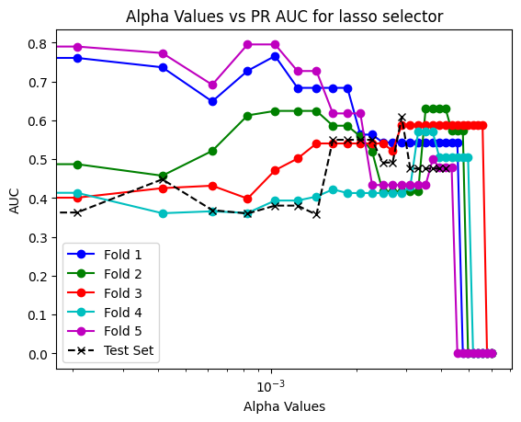
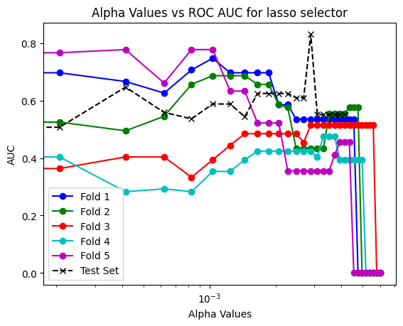
Results obtained with the best mean parameters on the test set for lasso and rf classifier alpha: 0.0018620689655172416 threshold: 0.41200000000000003 F1 score: 0.5 best_precision: 0.375 best_recall: 0.75 confusion matrix : [[ 7 10]
[ 2 6]]
test_accuracy: 0.52 pr_auc: 0.5497866909921864 roc_auc: 0.625

Slide 11
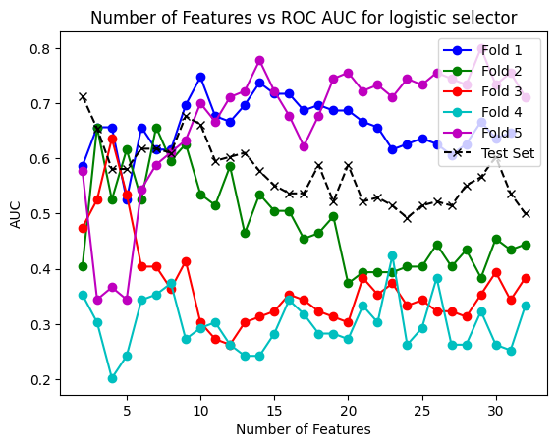
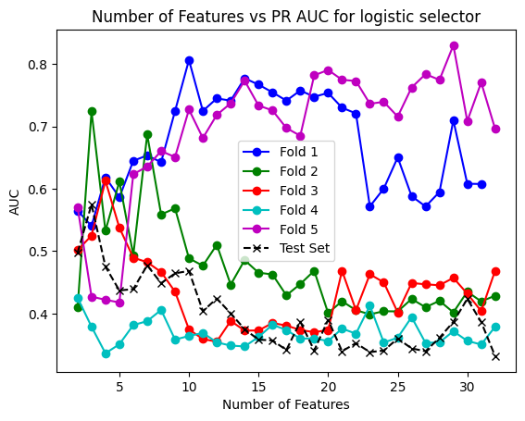
Results obtained with the best mean parameters on the test set for logistic and rf classifier Features: 9.6 threshold: 0.3742 F1 score: 0.5517241379310345 best_precision: 0.38095238095238093 best_recall: 1.0
confusion matrix : [[ 4 13]
[ 0 8]]
test_accuracy: 0.48 pr_auc: 0.37351190476190477 roc_auc: 0.5367647058823529

Slide 12
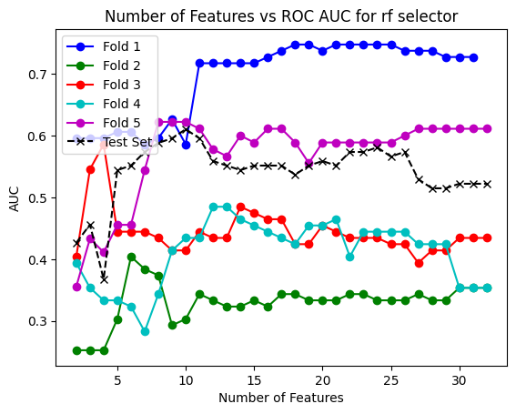
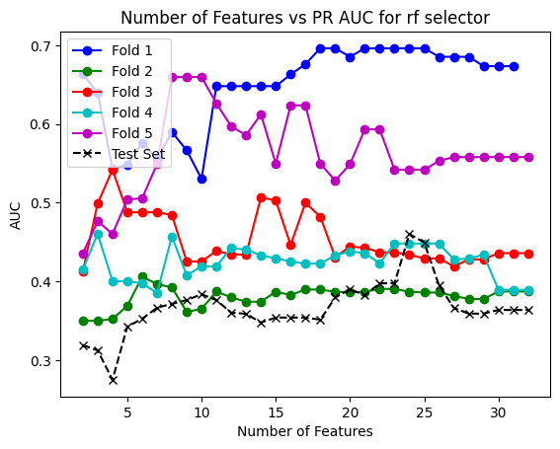
Results cross val logistic 2
lts obtained with the best mean parameters on the test set for rf and logistic classifier Features: 19.2 threshold: 0.4668 F1 score: 0.5 best_precision: 0.35 best_recall: 0.875 confusion matrix : [[ 4 13] [ 1 7]] test_accuracy: 0.44 pr_auc: 0.3637609649122807 roc_auc: 0.5220588235294117

Slide 13
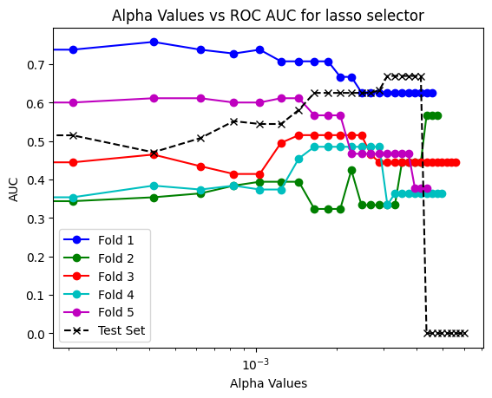
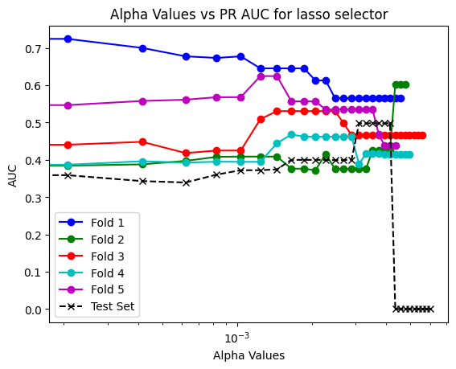
lts obtained with the best mean parameters on the test set for lasso and logistic classifier alpha: 0.0009517241379310345 threshold: 0.45940000000000003 F1 score: 0.5333333333333333 best_precision: 0.36363636363636365 best_recall: 1.0 confusion matrix : [[ 3 14] [ 0 8]] test_accuracy: 0.44 pr_auc: 0.3604059865573024 roc_auc: 0.5514705882352942

Slide 14
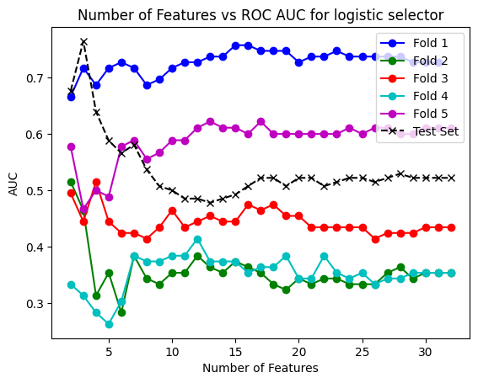
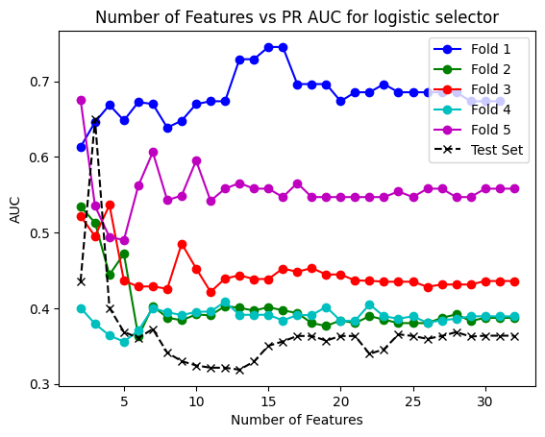
Results obtained with the best mean parameters on the test set for logistic and logistic classifier Features: 11.4 threshold: 0.4688 F1 score: 0.5 best_precision: 0.35 best_recall: 0.875 confusion matrix : [[ 4 13] [ 1 7]] test_accuracy: 0.44 pr_auc: 0.3637609649122807 roc_auc: 0.5220588235294117

Slide 15
Results cross val xgboost 2

Slide 18
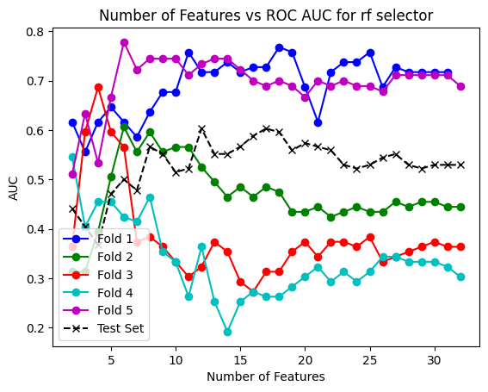
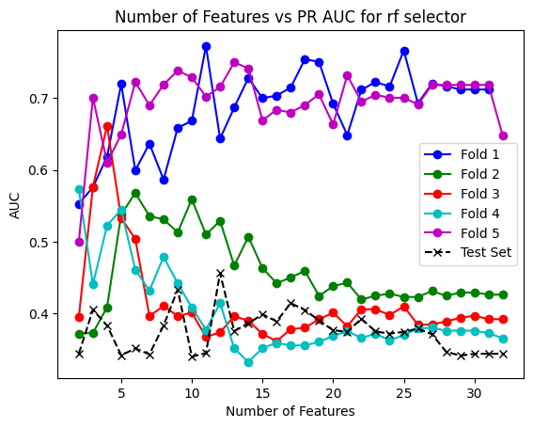
Results cross val svm 2
Results obtained with the best mean parameters on the test set for rf and svm classifier Features: 8.0 threshold: 0.4566 F1 score: 0.45454545454545453 best_precision: 0.35714285714285715 best_recall: 0.625 confusion matrix : [[8 9] [3 5]] test_accuracy: 0.52 pr_auc: 0.3438495124156889 roc_auc: 0.5294117647058824

Slide 19
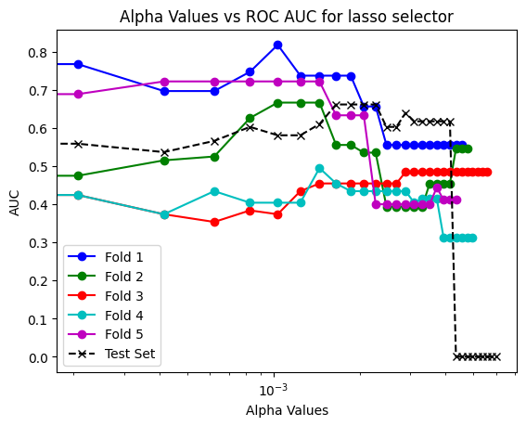
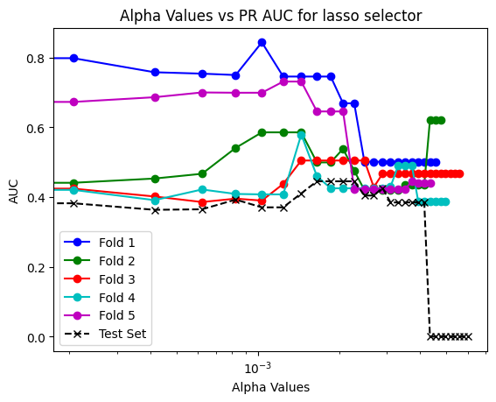
Results obtained with the best mean parameters on the test set for lasso and svm classifier alpha: 0.0014896551724137932 threshold: 0.44860000000000005 F1 score: 0.5833333333333334 best_precision: 0.4375 best_recall: 0.875 confusion matrix : [[8 9] [1 7]] test_accuracy: 0.6 pr_auc: 0.4105800642855596 roc_auc: 0.6102941176470589

Slide 20
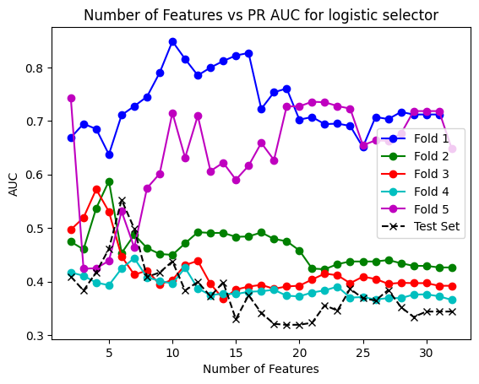
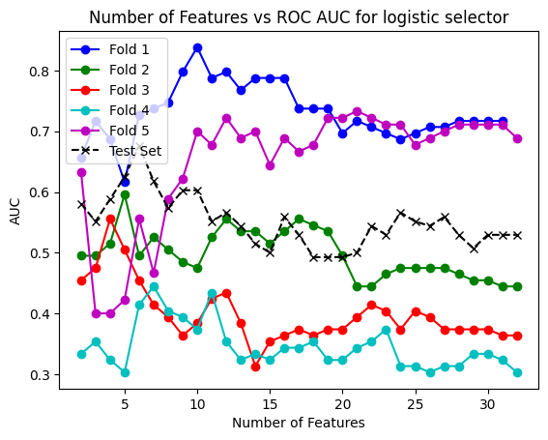
Results obtained with the best mean parameters on the test set for logistic and svm classifier Features: 13.2 threshold: 0.46259999999999996 F1 score: 0.47619047619047616 best_precision: 0.38461538461538464 best_recall: 0.625 confusion matrix : [[9 8] [3 5]] test_accuracy: 0.56 pr_auc: 0.3438495124156889 roc_auc: 0.5294117647058824

Slide 21
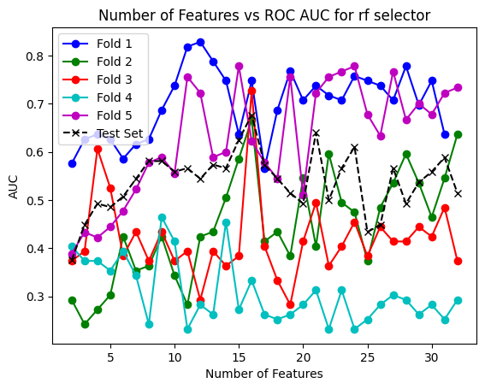
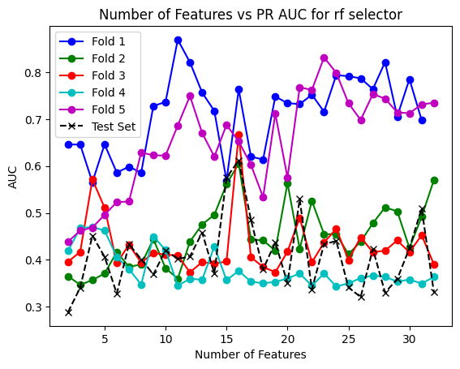
Results cross val mlp 2
Results obtained with the best mean parameters on the test set for rf and mlp classifier Features: 16.4 threshold: 0.4640000000000001 F1 score: 0.45454545454545453 best_precision: 0.35714285714285715 best_recall: 0.625 confusion matrix : [[8 9] [3 5]] test_accuracy: 0.52 pr_auc: 0.3327075336943758 roc_auc: 0.5

Slide 22
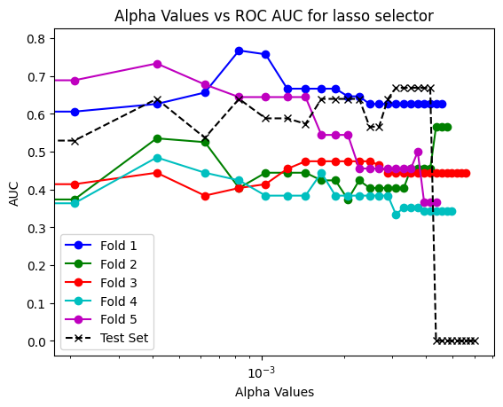
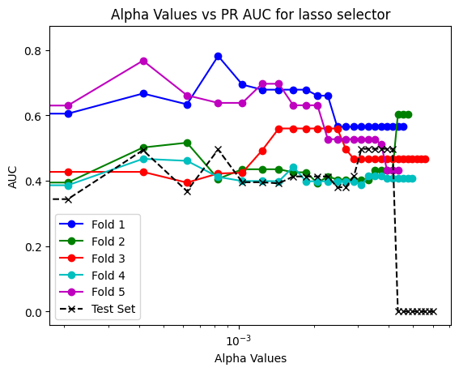
Results obtained with the best mean parameters on the test set for lasso and mlp classifier alpha: 0.0008275862068965516 threshold: 0.46180000000000004 F1 score: 0.5 best_precision: 0.3333333333333333 best_recall: 1.0 confusion matrix : [[ 1 16] [ 0 8]] test_accuracy: 0.36 pr_auc: 0.4958158263305322 roc_auc: 0.6397058823529411

Slide 23
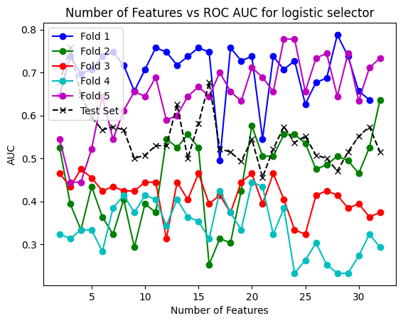
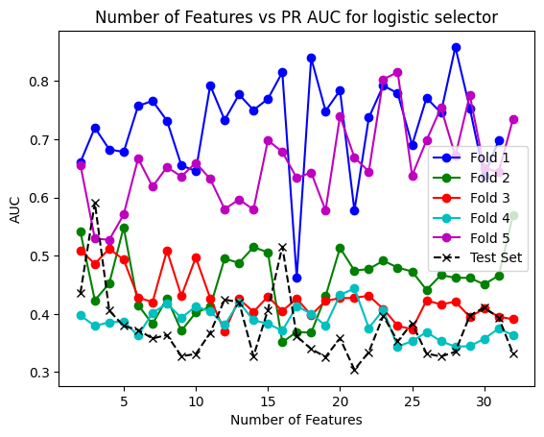
Results obtained with the best mean parameters on the test set for logistic and mlp classifier Features: 17.8 threshold: 0.4732 F1 score: 0.5217391304347826 best_precision: 0.4 best_recall: 0.75 confusion matrix : [[8 9] [2 6]] test_accuracy: 0.56 pr_auc: 0.39734952547452546 roc_auc: 0.4632352941176471

Slide 24
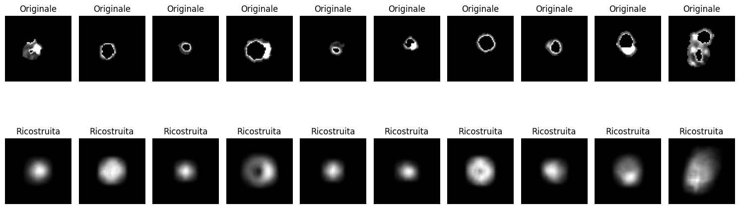
Autoencoder 2.1 salvato in encodereasy32second
def decoder(encoded_shape):
inputs = Input(shape=encoded_shape)
x = Dense(8 * 8 * 32, activation='relu')(inputs)
x = Reshape((8, 8, 32))(x)
x = UpSampling2D((2, 2))(x)
x = Conv2D(32, (3, 3), activation='relu', padding='same')(x)
x = BatchNormalization()(x)
x = UpSampling2D((2, 2))(x)
x = Conv2D(16, (3, 3), activation='relu', padding='same')(x)
x = BatchNormalization()(x)
x = UpSampling2D((2, 2))(x)
x = Conv2D(8, (3, 3), activation='relu', padding='same')(x)
x = BatchNormalization()(x)
decoded = Conv2D(1, (3, 3), activation='sigmoid', padding='same')(x)
decoder_model = Model(inputs, decoded, name='decoder')
def encoder(input_shape):
inputs = Input(shape=input_shape)
x = Conv2D(8, (3, 3), activation='relu', padding='same')(inputs)
x = BatchNormalization()(x)
x = MaxPooling2D((2, 2), padding='same')(x)
x = Conv2D(16, (3, 3), activation='relu', padding='same')(x)
x = BatchNormalization()(x)
x = MaxPooling2D((2, 2), padding='same')(x)
x = GlobalAveragePooling2D()(x)
encoded = Dense(32, activation='relu', kernel_regularizer=l1(10e-8))(x)
encoder_model = Model(inputs, encoded, name='encoder')
encoder_model.summary()
return encoder_model
Mean SSIM: 0.09407887282518303 and Mean SSIM with mask: 0.6923751312235046 Mean Cosine Similarity: 0.5395139324001171 and Mean Cosine Similarity with mask: 0.8196072432540965 Mean MSE: 0.015491451591503032 Mean PSNR: 18.842114399048242 Mean NRMSE: 0.120588805059898 Mean Manhattan Distance: 165.25503540039062 Mean Euclidean Distance: 7.644992828369141

Slide 25
Autoencoder 4
def decoder(encoded_shape):
inputs = Input(shape=encoded_shape)
x = Dense(8 * 8 * 32, activation='relu')(inputs)
x = Reshape((8, 8, 32))(x)
x = UpSampling2D((2, 2))(x)
x = Conv2D(32, (3, 3), activation='relu', padding='same')(x)
x = BatchNormalization()(x)
x = UpSampling2D((2, 2))(x)
x = Conv2D(16, (3, 3), activation='relu', padding='same')(x)
x = BatchNormalization()(x)
x = UpSampling2D((2, 2))(x)
x = Conv2D(8, (3, 3), activation='relu', padding='same')(x)
x = BatchNormalization()(x)
decoded = Conv2D(1, (3, 3), activation='sigmoid', padding='same')(x)
decoder_model = Model(inputs, decoded, name='decoder')
decoder_model.summary()
return decoder_model
autoencoder_model.compile(optimizer=AdamW(learning_rate=learning_rate), loss='binary_crossentropy')
import tensorflow as tf
from tensorflow.keras.layers import Input, Conv2D, MaxPooling2D, UpSampling2D, Dense, Flatten, Reshape, GlobalAveragePooling2D, BatchNormalization
from tensorflow.keras.models import Model
from tensorflow.keras.optimizers import Adam
from tensorflow.keras.regularizers import l1
## MODELLO PIU SEMPLICE (CON MENO PARAMETRI)
def encoder(input_shape):
inputs = Input(shape=input_shape)
x = Conv2D(8, (3, 3), activation='relu', padding='same')(inputs)
x = BatchNormalization()(x)
x = MaxPooling2D((2, 2), padding='same')(x)
x = Conv2D(16, (3, 3), activation='relu', padding='same')(x)
x = BatchNormalization()(x)
x = MaxPooling2D((2, 2), padding='same')(x)
x = GlobalAveragePooling2D()(x)
encoded = Dense(32, activation='relu', kernel_regularizer=l1(10e-8))(x)
encoder_model = Model(inputs, encoded, name='encoder')
encoder_model.summary()
return encoder_model

Slide 26
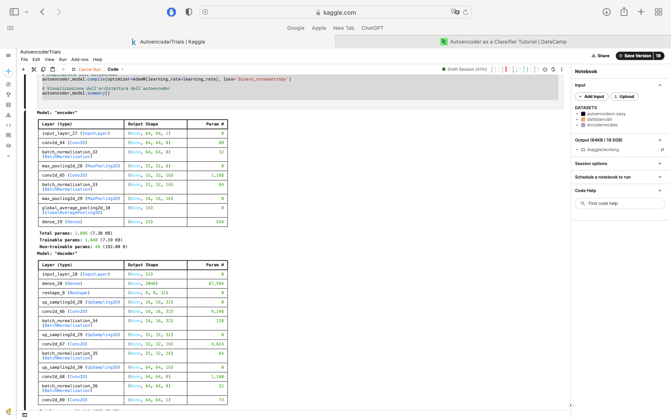
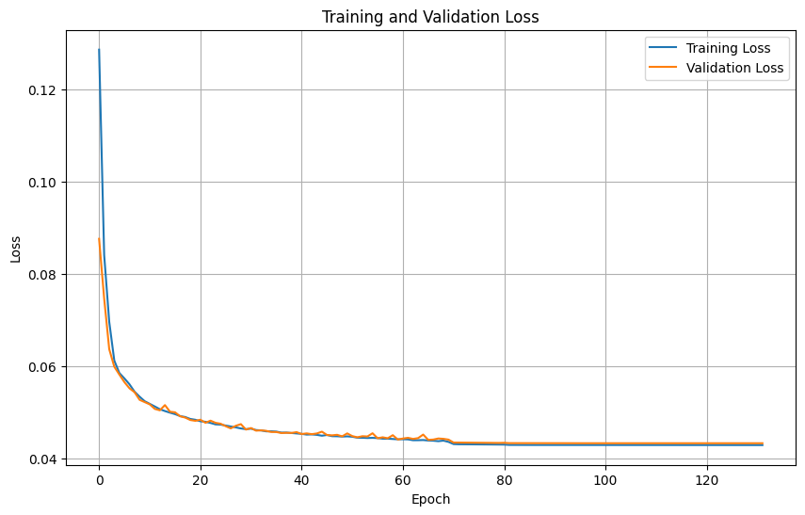
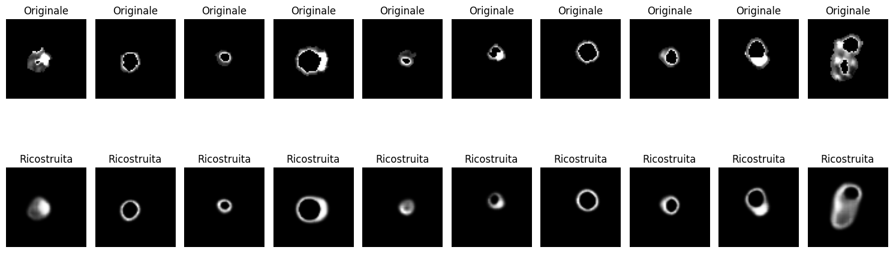
Mean SSIM: 0.4603666666836401 and Mean SSIM with mask: 0.9275225003809517 Mean Cosine Similarity: 0.8736893393510092 and Mean Cosine Similarity with mask: 0.9153537669194579 Mean MSE: 0.004948279824774292 Mean PSNR: 23.881423988106267 Mean NRMSE: 0.06780633229153517 Mean Manhattan Distance: 62.82537841796875 Mean Euclidean Distance: 4.294457912445068

Slide 27
1 Risultati
Ottenuti con stratified kfold, test size = 0.2 allenando il classificatore per il test con la best threshold trovata per ogni fold e poi fatta la media di queste e allenata su tutto il set di train

Slide 28
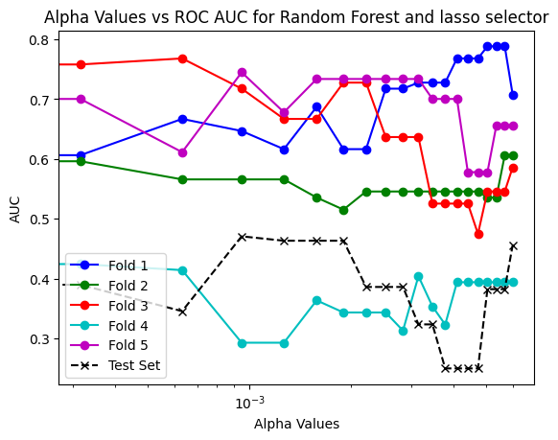
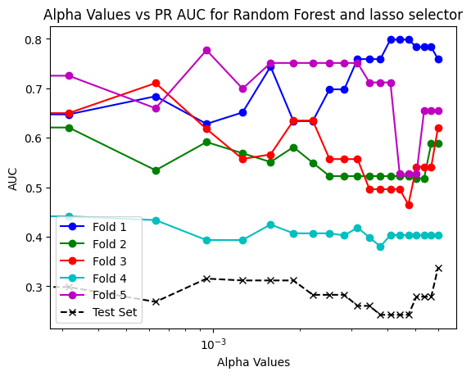

Slide 29
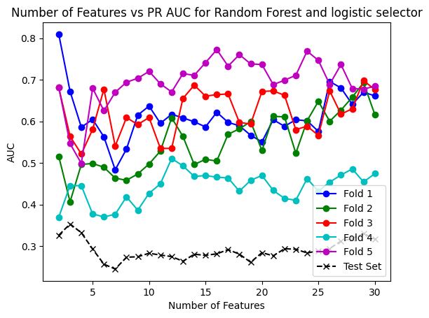
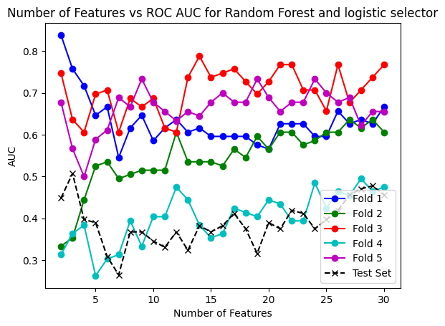

Slide 30
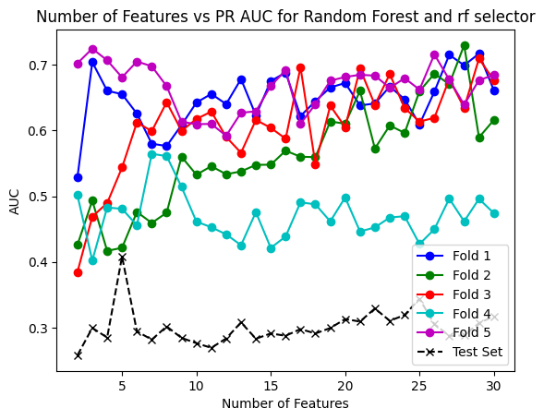
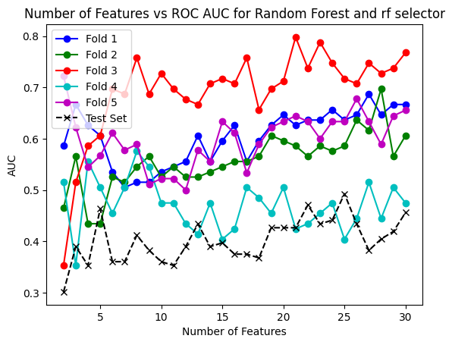

Slide 31
Ora per trovare i risultati migliori prendo per il caso migliore di ogni fold il miglior alpha e num features e faccio la media, poi alleno il classificatore con quei parametri (best_threshold uguale)
Results obtained with the best mean parameters on the test set for lasso and rf classifier
alpha: 0.002589473684210526
threshold: 0.33019999999999994
F1 score: 0.5333333333333333
best_precision: 0.36363636363636365
best_recall: 1.0
confusion matrix : [[ 3 14] [
0 8]]
test_accuracy: 0.44
pr_auc: 0.28254502259436465
roc_auc: 0.38602941176470595
Results obtained with the best mean parameters on the test set for rf and rf classifier
Features: 13.4
threshold: 0.44000000000000006
F1 score: 0.2222222222222222
best_precision: 0.2
best_recall: 0.25
confusion matrix : [[9 8]
[6 2]]
test_accuracy: 0.44
pr_auc: 0.3278856572013037 roc_auc: 0.4632352941176471
Results obtained with the best mean parameters on the test set for logistic and rf classifier
Features: 12.2 threshold: 0.42400000000000004
F1 score: 0.3157894736842105 best_precision: 0.2727272727272727 best_recall: 0.375
confusion matrix : [[9 8]
[5 3]]
test_accuracy: 0.48
pr_auc: 0.3142314659977703 roc_auc: 0.4632352941176471

Slide 32
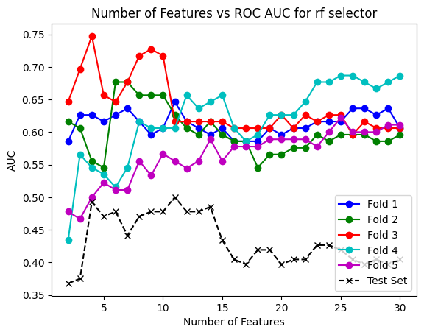
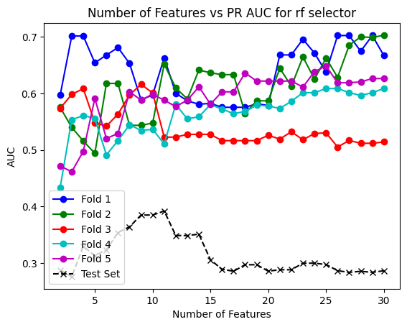
Results with logistic

Slide 33
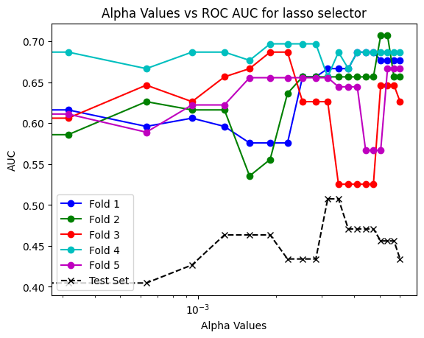
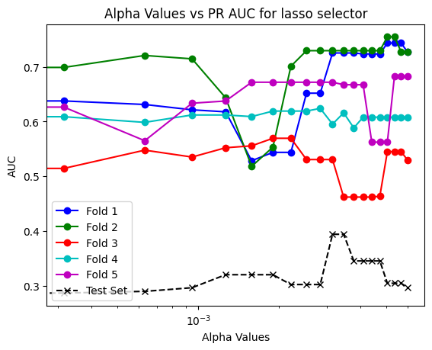

Slide 34
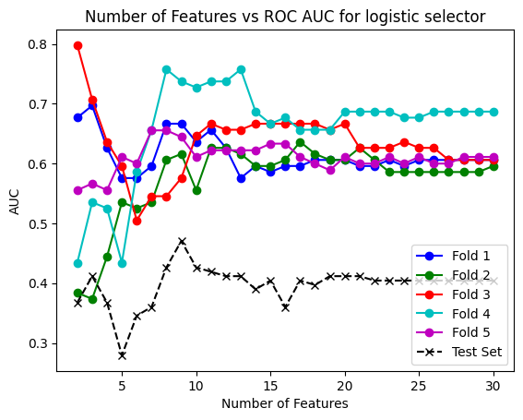
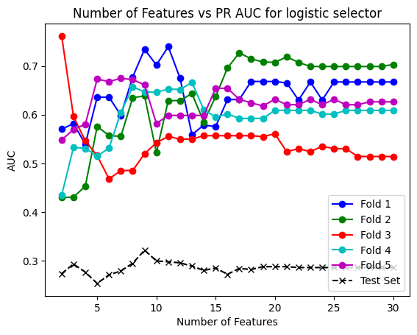

Slide 35
Results obtained with the best mean parameters on the test set for logistic and logistic classifier Features: 8.8 threshold: 0.47519999999999996 F1 score: 0.36363636363636365 best_precision: 0.2857142857142857 best_recall: 0.5 confusion matrix : [[ 7 10] [ 4 4]] test_accuracy: 0.44 pr_auc: 0.28645632510764085 roc_auc: 0.40441176470588236
Results obtained with the best mean parameters on the test set for lasso and logistic classifier alpha: 0.0030947368421052634 threshold: 0.4772 F1 score: 0.36363636363636365 best_precision: 0.2857142857142857 best_recall: 0.5 confusion matrix : [[ 7 10] [ 4 4]] test_accuracy: 0.44 pr_auc: 0.3938842886652989 roc_auc: 0.5073529411764706
Results obtained with the best mean parameters on the test set for rf and logistic classifier Features: 11.0 threshold: 0.472 F1 score: 0.36363636363636365 best_precision: 0.2857142857142857 best_recall: 0.5 confusion matrix : [[ 7 10] [ 4 4]] test_accuracy: 0.44 pr_auc: 0.28645632510764085 roc_auc: 0.40441176470588236

Slide 36
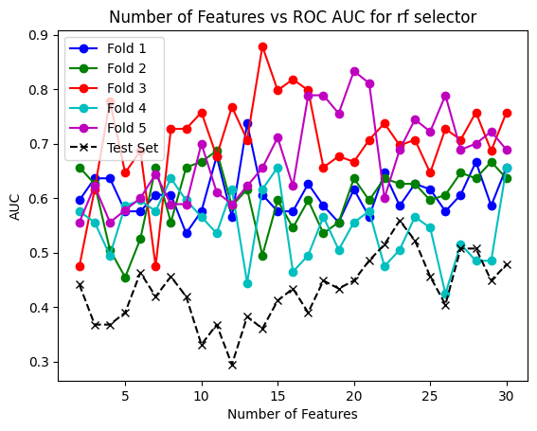
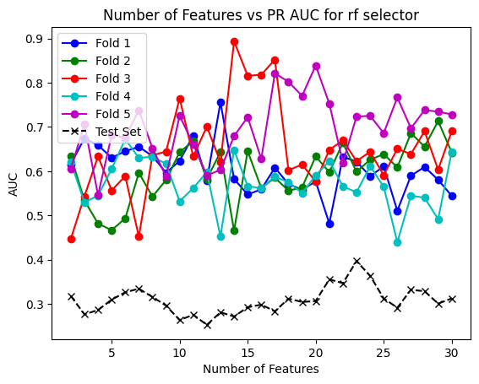
Results with MLP

Slide 37
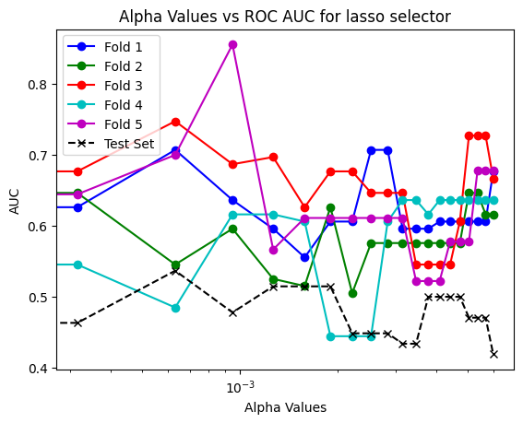
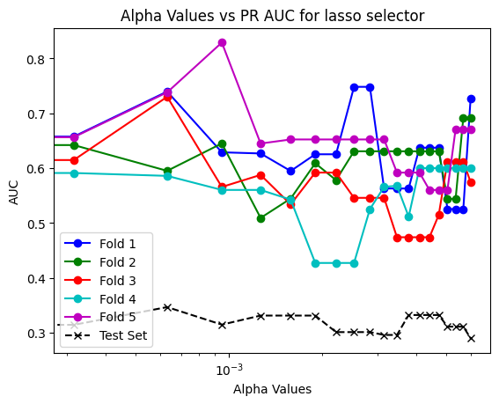

Slide 38
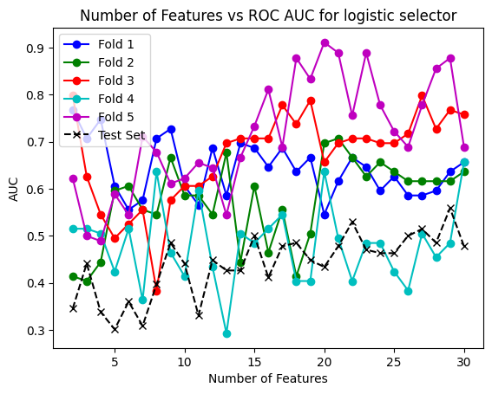


Slide 39
Results obtained with the best mean parameters on the test set for logistic and mlp classifier Features: 13.4 threshold: 0.42960000000000004 F1 score: 0.35294117647058826 best_precision: 0.3333333333333333 best_recall: 0.375 confusion matrix : [[11 6] [ 5 3]] test_accuracy: 0.56 pr_auc: 0.3347204561649221 roc_auc: 0.5073529411764706
Results obtained with the best mean parameters on the test set for lasso and mlp classifier alpha: 0.0034736842105263155 threshold: 0.421 F1 score: 0.4 best_precision: 0.29411764705882354 best_recall: 0.625 confusion matrix : [[ 5 12] [ 3 5]] test_accuracy: 0.4 pr_auc: 0.2961528534338636 roc_auc: 0.4338235294117647
Results obtained with the best mean parameters on the test set for rf and mlp classifier Features: 13.0 threshold: 0.3946 F1 score: 0.48 best_precision: 0.35294117647058826 best_recall: 0.75 confusion matrix : [[ 6 11] [ 2 6]] test_accuracy: 0.48 pr_auc: 0.28909890311786596 roc_auc: 0.4117647058823529

Slide 40


Results with svm

Slide 41



Slide 42



Slide 43
Results obtained with the best mean parameters on the test set for logistic and svm classifier Features: 10.8 threshold: 0.4626 F1 score: 0.25 best_precision: 0.25 best_recall: 0.25 confusion matrix : [[11 6] [ 6 2]] test_accuracy: 0.52 pr_auc: 0.3179414528969482 roc_auc: 0.4926470588235294
Results obtained with the best mean parameters on the test set for lasso and svm classifier alpha: 0.0015157894736842104 threshold: 0.3554 F1 score: 0.48 best_precision: 0.35294117647058826 best_recall: 0.75 confusion matrix : [[ 6 11] [ 2 6]] test_accuracy: 0.48 pr_auc: 0.3367965367965368 roc_auc: 0.5147058823529411
Results obtained with the best mean parameters on the test set for rf and svm classifier Features: 14.6 threshold: 0.392 F1 score: 0.38095238095238093 best_precision: 0.3076923076923077 best_recall: 0.5 confusion matrix : [[8 9] [4 4]] test_accuracy: 0.48 pr_auc: 0.3179414528969482 roc_auc: 0.4926470588235294

Slide 44


Results with XGBClassifier

Slide 45



Slide 46



Slide 47
Results obtained with the best mean parameters on the test set for logistic and xgb classifier Features: 11.8 threshold: 0.3246 F1 score: 0.47619047619047616 best_precision: 0.38461538461538464 best_recall: 0.625 confusion matrix : [[9 8] [3 5]] test_accuracy: 0.56 pr_auc: 0.31068965756465755 roc_auc: 0.47058823529411764
Results obtained with the best mean parameters on the test set for lasso and xgb classifier alpha: 0.0024000000000000002 threshold: 0.3762 F1 score: 0.4 best_precision: 0.3333333333333333 best_recall: 0.5 confusion matrix : [[9 8] [4 4]] test_accuracy: 0.52 pr_auc: 0.30168775970406403 roc_auc: 0.4411764705882353
Results obtained with the best mean parameters on the test set for rf and xgb classifier Features: 10.8 threshold: 0.3408 F1 score: 0.3 best_precision: 0.25 best_recall: 0.375 confusion matrix : [[8 9] [5 3]] test_accuracy: 0.44 pr_auc: 0.32915228046806994 roc_auc: 0.5147058823529411

Slide 48



Leave One out RF
The alpha with the best accuracy is 0.0 with accuracy of 0.5959595959595959
The best number of features for logistic is 24 with a accuracy of 0.6262626262626263
The best number of features for rf is 4 with a accuracy of 0.6363636363636364

Slide 49
Sul set di test
For rf selector f1 is 0.15384615384615385, accuracy is 0.56, pr_auc is 0.284839845826688 and roc_auc is 0.35294117647058826
For lasso selector f1 is 0.14285714285714285, accuracy is 0.52, pr_auc is 0.3173266700404858 and roc_auc is 0.45588235294117646
For logistic selector f1 is 0.13333333333333333, accuracy is 0.48, pr_auc is 0.28359010270774976 and roc_auc is 0.37

Slide 50

Autoencoder 4
Senza strato denso e 64 features
Mean SSIM: 0.39071419734458496 and Mean SSIM with mask: 0.9178957200903402 Mean Cosine Similarity: 0.8528682871167099 and Mean Cosine Similarity with mask: 0.9028977548355049 Mean MSE: 0.005553397856900883 Mean PSNR: 23.19978775405768 Mean NRMSE: 0.07259436529704383 Mean Manhattan Distance: 69.34285736083984 Mean Euclidean Distance: 4.597649097442627

Slide 51


Mobilenet 64
Mobilenet 32

Slide 53
GRAFICI AUTOENCODERS FINALI

Slide 54





Autoencoder 128
PR AUC

Slide 55





Autoencoder 128
ROC AUC

Slide 56
Miglior risultato per il classificatore RandomForest (selector lasso): F1 score: 0.8125 PR AUC: 0.6241419294990723 ROC AUC: 0.7366071428571429 Accuracy: 0.8 Numero di features: 12 Confusion Matrix: [[11 5] [ 1 13]] Best Precision: 0.7222222222222222 Best Recall: 0.9285714285714286 Best Threshold: 0.47000000000000003 Selected Features: [15 16 30 31 32 51 57 58 75 78 87 89] Alpha: 0.002689655172413793 -------------------- -------------------- Miglior risultato per il classificatore Logistic (selector logistic): F1 score: 0.8484848484848485 PR AUC: 0.6376203978094735 ROC AUC: 0.7857142857142857 Accuracy: 0.8333333333333334 Numero di features: 6 Confusion Matrix: [[11 5] [ 0 14]] Best Precision: 0.7368421052631579 Best Recall: 1.0 Best Threshold: 0.443 Selected Features: [56 0 72 78 50 98] -------------------- -------------------- Miglior risultato per il classificatore XgBoost (selector rf): F1 score: 0.8235294117647058 PR AUC: 0.5824281934996222 ROC AUC: 0.6473214285714286 Accuracy: 0.8 Numero di features: 48 Confusion Matrix: [[10 6] [ 0 14]] Best Precision: 0.7 Best Recall: 1.0 Best Threshold: 0.20700000000000002 Selected Features: [72 87 56 28 59 38 22 86 36 66 26 42 98 88 60 50 27 75 45 80 89 32 44 34 18 78 92 90 68 30 77 15 95 20 23 19 12 82 4 58 13 2 65 41 54 74 46 85] -------------------- -------------------- Miglior risultato per il classificatore MLP (selector logistic): F1 score: 0.8484848484848485 PR AUC: 0.7439275010703581 ROC AUC: 0.8348214285714286 Accuracy: 0.8333333333333334 Numero di features: 10 Confusion Matrix: [[11 5] [ 0 14]] Best Precision: 0.7368421052631579 Best Recall: 1.0 Best Threshold: 0.486 Selected Features: [56 0 72 78 50 98 90 85 51 24] -------------------- -------------------- Miglior risultato per il classificatore SVM (selector rf): F1 score: 0.8235294117647058 PR AUC: 0.6079546028324224 ROC AUC: 0.7053571428571429 Accuracy: 0.8 Numero di features: 5 Confusion Matrix: [[10 6] [ 0 14]] Best Precision: 0.7 Best Recall: 1.0 Best Threshold: 0.433 Selected Features: [72 87 56 28 59]

Slide 57

classifier: MLP
selector: logistic
F1 score finale: 0.4666666666666667 Precision finale: 0.3181818181818182 Recall finale: 0.875
Confusion Matrix finale:
[[ 2 15]
[ 1 7]]
Accuracy finale: 0.36
threshold: 0.486
Num_features: 99

Slide 58





Autoencoder 128
No Shuffle

Slide 59






Slide 60
Miglior risultato per il classificatore RandomForest (selector rf): F1 score: 0.6666666666666666 PR AUC: 0.6134787594796896 ROC AUC: 0.69377990430622 Accuracy: 0.6333333333333333 Numero di features: 6 Confusion Matrix: [[ 8 11] [ 0 11]] Best Precision: 0.5 Best Recall: 1.0 Best Threshold: 0.4 Selected Features: [68 56 83 55 26 30] -------------------- -------------------- Miglior risultato per il classificatore Logistic (selector rf): F1 score: 0.6285714285714286 PR AUC: 0.5824030960127217 ROC AUC: 0.6794258373205742 Accuracy: 0.5666666666666667 Numero di features: 9 Confusion Matrix: [[ 6 13] [ 0 11]] Best Precision: 0.4583333333333333 Best Recall: 1.0 Best Threshold: 0.44 Selected Features: [68 56 83 55 26 30 10 93 42] -------------------- -------------------- Miglior risultato per il classificatore XgBoost (selector rf): F1 score: 0.6666666666666666 PR AUC: 0.6763855769273726 ROC AUC: 0.7129186602870814 Accuracy: 0.6333333333333333 Numero di features: 6 Confusion Matrix: [[ 8 11] [ 0 11]] Best Precision: 0.5 Best Recall: 1.0 Best Threshold: 0.26 Selected Features: [68 56 83 55 26 30] -------------------- -------------------- Miglior risultato per il classificatore MLP (selector rf): F1 score: 0.6666666666666666 PR AUC: 0.5377528537568136 ROC AUC: 0.583732057416268 Accuracy: 0.6666666666666666 Numero di features: 8 Confusion Matrix: [[10 9] [ 1 10]] Best Precision: 0.5263157894736842 Best Recall: 0.9090909090909091 Best Threshold: 0.45 Selected Features: [68 56 83 55 26 30 10 93] -------------------- -------------------- Miglior risultato per il classificatore SVM (selector rf): F1 score: 0.6451612903225806 PR AUC: 0.537755797585213 ROC AUC: 0.5789473684210527 Accuracy: 0.6333333333333333 Numero di features: 2 Confusion Matrix: [[ 9 10] [ 1 10]] Best Precision: 0.5 Best Recall: 0.9090909090909091 Best Threshold: 0.4 Selected Features: [68 56]

Slide 61

classifier: XgBoost selector: rf F1 score finale: 0.45161290322580644 Precision finale: 0.30434782608695654 Recall finale: 0.875 Confusion Matrix finale: [[ 1 16] [ 1 7]] Accuracy finale: 0.32 threshold: 0.26
Number of features: 94

Slide 62





Autoencoder 64
No Shuffle

Slide 63






Slide 64
Miglior risultato per il classificatore RandomForest (selector logistic): F1 score: 0.6666666666666666 PR AUC: 0.5456665484810713 ROC AUC: 0.6650717703349283 Accuracy: 0.6666666666666666 Numero di features: 12 Confusion Matrix: [[10 9] [ 1 10]] Best Precision: 0.5263157894736842 Best Recall: 0.9090909090909091 Best Threshold: 0.49 Selected Features: [ 4 16 38 35 50 6 25 49 26 43 13 8] -------------------- -------------------- Miglior risultato per il classificatore Logistic (selector logistic): F1 score: 0.7142857142857143 PR AUC: 0.7341023012075645 ROC AUC: 0.7894736842105263 Accuracy: 0.7333333333333333 Numero di features: 4 Confusion Matrix: [[12 7] [ 1 10]] Best Precision: 0.5882352941176471 Best Recall: 0.9090909090909091 Best Threshold: 0.485 Selected Features: [ 4 16 38 35] -------------------- -------------------- Miglior risultato per il classificatore XgBoost (selector lasso): F1 score: 0.6666666666666666 PR AUC: 0.5997113252531209 ROC AUC: 0.6698564593301436 Accuracy: 0.7 Numero di features: 10 Confusion Matrix: [[12 7] [ 2 9]] Best Precision: 0.5625 Best Recall: 0.8181818181818182 Best Threshold: 0.47300000000000003 Selected Features: [ 4 15 19 21 22 33 35 38 48 50] Alpha: 0.0022758620689655173 -------------------- -------------------- Miglior risultato per il classificatore MLP (selector logistic): F1 score: 0.7407407407407407 PR AUC: 0.7206830821920337 ROC AUC: 0.7894736842105263 Accuracy: 0.7666666666666667 Numero di features: 4 Confusion Matrix: [[13 6] [ 1 10]] Best Precision: 0.625 Best Recall: 0.9090909090909091 Best Threshold: 0.499 Selected Features: [ 4 16 38 35] -------------------- -------------------- Miglior risultato per il classificatore SVM (selector logistic): F1 score: 0.6666666666666666 PR AUC: 0.5985547891767987 ROC AUC: 0.6507177033492824 Accuracy: 0.6333333333333333 Numero di features: 4 Confusion Matrix: [[ 8 11] [ 0 11]] Best Precision: 0.5 Best Recall: 1.0 Best Threshold: 0.431 Selected Features: [ 4 16 38 35]

Slide 65

classifier: MLP selector: logistic F1 score finale: 0.46153846153846156 Precision finale: 0.6 Recall finale: 0.375 Confusion Matrix finale: [[15 2]
[ 5 3]]
Accuracy finale: 0.72 threshold: 0.499
Num_featuree: 52

Slide 66





Autoencoder 32
Con shuffle

Slide 67






Slide 68
Miglior risultato per il classificatore RandomForest (selector logistic): F1 score: 0.7567567567567568 PR AUC: 0.6480215419501135 ROC AUC: 0.7276785714285714 Accuracy: 0.7 Numero di features: 3 Confusion Matrix: [[ 7 9] [ 0 14]] Best Precision: 0.6086956521739131 Best Recall: 1.0 Best Threshold: 0.44 Selected Features: [27 6 7] -------------------- -------------------- Miglior risultato per il classificatore Logistic (selector lasso): F1 score: 0.7586206896551724 PR AUC: 0.8593846853629461 ROC AUC: 0.8125 Accuracy: 0.7666666666666667 Numero di features: 7 Confusion Matrix: [[12 4] [ 3 11]] Best Precision: 0.7333333333333333 Best Recall: 0.7857142857142857 Best Threshold: 0.489 Selected Features: [ 0 6 7 12 13 17 27] Alpha: 0.003103448275862069 -------------------- -------------------- Miglior risultato per il classificatore XgBoost (selector logistic): F1 score: 0.7647058823529411 PR AUC: 0.7086658510571552 ROC AUC: 0.8169642857142857 Accuracy: 0.7333333333333333 Numero di features: 4 Confusion Matrix: [[ 9 7] [ 1 13]] Best Precision: 0.65 Best Recall: 0.9285714285714286 Best Threshold: 0.311 Selected Features: [27 6 7 8] -------------------- -------------------- Miglior risultato per il classificatore MLP (selector mrmr): F1 score: 0.8125 PR AUC: 0.7098823795252367 ROC AUC: 0.7767857142857143 Accuracy: 0.8 Numero di features: 11 Confusion Matrix: [[11 5] [ 1 13]] Best Precision: 0.7222222222222222 Best Recall: 0.9285714285714286 Best Threshold: 0.41300000000000003 Selected Features: [7, 3, 16, 22, 11, 19, 14, 28, 9, 17, 20] -------------------- -------------------- Miglior risultato per il classificatore SVM (selector lasso): F1 score: 0.8666666666666667 PR AUC: 0.8456937926685826 ROC AUC: 0.8571428571428572 Accuracy: 0.8666666666666667 Numero di features: 5 Confusion Matrix: [[13 3] [ 1 13]] Best Precision: 0.8125 Best Recall: 0.9285714285714286 Best Threshold: 0.489 Selected Features: [ 6 7 13 17 27] Alpha: 0.0037241379310344828 --------------------

Slide 69

classifier: SVM selector: lasso F1 score finale: 0.125 Precision finale: 0.125 Recall finale: 0.125 Confusion Matrix finale: [[10 7] [ 7 1]] Accuracy finale: 0.44 threshold: 0.489 features: [0, 1, 2, 3, 4, 5, 6, 7, 8, 9, 10, 11, 12, 13, 14, 15, 16, 17, 18, 19, 20, 21, 22, 23, 24, 25, 26, 27, 28, 29] e sono 30

Slide 70





Autoencoder 32
No shuffle

Slide 71






Slide 72
Miglior risultato per il classificatore RandomForest (selector logistic): F1 score: 0.6111111111111112 PR AUC: 0.39581159581159575 ROC AUC: 0.569377990430622 Accuracy: 0.5333333333333333 Numero di features: 2 Confusion Matrix: [[ 5 14] [ 0 11]] Best Precision: 0.44 Best Recall: 1.0 Best Threshold: 0.42 Selected Features: [6 7] -------------------- -------------------- Miglior risultato per il classificatore Logistic (selector mrmr): F1 score: 0.6285714285714286 PR AUC: 0.5911478442438195 ROC AUC: 0.631578947368421 Accuracy: 0.5666666666666667 Numero di features: 19 Confusion Matrix: [[ 6 13] [ 0 11]] Best Precision: 0.4583333333333333 Best Recall: 1.0 Best Threshold: 0.445 Selected Features: [26, 1, 29, 9, 11, 28, 17, 19, 14, 22, 8, 2, 18, 4, 7, 16, 3, 20, 21] -------------------- -------------------- Miglior risultato per il classificatore XgBoost (selector mrmr): F1 score: 0.6 PR AUC: 0.4560031574138157 ROC AUC: 0.6076555023923446 Accuracy: 0.6 Numero di features: 4 Confusion Matrix: [[ 9 10] [ 2 9]] Best Precision: 0.47368421052631576 Best Recall: 0.8181818181818182 Best Threshold: 0.468 Selected Features: [26, 1, 29, 9] -------------------- -------------------- Miglior risultato per il classificatore MLP (selector mrmr): F1 score: 0.6285714285714286 PR AUC: 0.5228802837091607 ROC AUC: 0.5645933014354068 Accuracy: 0.5666666666666667 Numero di features: 9 Confusion Matrix: [[ 6 13] [ 0 11]] Best Precision: 0.4583333333333333 Best Recall: 1.0 Best Threshold: 0.418 Selected Features: [26, 1, 29, 9, 11, 28, 17, 19, 14] -------------------- -------------------- Miglior risultato per il classificatore SVM (selector logistic): F1 score: 0.6666666666666666 PR AUC: 0.6216471752317466 ROC AUC: 0.6602870813397129 Accuracy: 0.6666666666666666 Numero di features: 15 Confusion Matrix: [[10 9] [ 1 10]] Best Precision: 0.5263157894736842 Best Recall: 0.9090909090909091 Best Threshold: 0.426 Selected Features: [ 6 7 27 5 17 19 8 28 4 25 9 20 22 11 10] --------------------

Slide 73

classifier: SVM selector: logistic F1 score finale: 0.43478260869565216 Precision finale: 0.3333333333333333 Recall finale: 0.625 Confusion Matrix finale: [[ 7 10] [ 3 5]] Accuracy finale: 0.48 threshold: 0.426 features: [0, 1, 2, 3, 4, 5, 6, 7, 8, 9, 10, 11, 12, 13, 14, 15, 16, 17, 18, 19, 20, 21, 22, 23, 24, 25, 26, 27, 28, 29] e sono 30

Slide 74





Autoencoder 64
Senza strato Denso
PR AUC

Slide 75
Autoencoder 64
Senza strato Denso
Roc AUC

Slide 76
Miglior risultato per il classificatore RandomForest (selector logistic): F1 score: 0.8 PR AUC: 0.6889572962051953 ROC AUC: 0.7678571428571428 Accuracy: 0.8 Numero di features: 5 Confusion Matrix: [[12 4] [ 2 12]] Best Precision: 0.75 Best Recall: 0.8571428571428571 Best Threshold: 0.46 Selected Features: [14 15 12 39 53] -------------------- -------------------- Miglior risultato per il classificatore Logistic (selector mrmr): F1 score: 0.8235294117647058 PR AUC: 0.6913858972616159 ROC AUC: 0.7678571428571429 Accuracy: 0.8 Numero di features: 26 Confusion Matrix: [[10 6] [ 0 14]] Best Precision: 0.7 Best Recall: 1.0 Best Threshold: 0.452 Selected Features: [18, 16, 30, 46, 49, 36, 40, 50, 52, 26, 8, 44, 45, 55, 27, 9, 32, 28, 3, 37, 21, 10, 19, 2, 42, 53] -------------------- -------------------- Miglior risultato per il classificatore XgBoost (selector mrmr): F1 score: 0.8 PR AUC: 0.6428593931251435 ROC AUC: 0.7098214285714286 Accuracy: 0.8 Numero di features: 13 Confusion Matrix: [[12 4] [ 2 12]] Best Precision: 0.75 Best Recall: 0.8571428571428571 Best Threshold: 0.403 Selected Features: [18, 16, 52, 36, 30, 40, 46, 49, 50, 26, 8, 44, 45] -------------------- -------------------- Miglior risultato per il classificatore MLP (selector mrmr): F1 score: 0.8125 PR AUC: 0.7106331891731053 ROC AUC: 0.7767857142857143 Accuracy: 0.8 Numero di features: 26 Confusion Matrix: [[11 5] [ 1 13]] Best Precision: 0.7222222222222222 Best Recall: 0.9285714285714286 Best Threshold: 0.499 Selected Features: [18, 16, 40, 49, 46, 30, 52, 36, 50, 26, 8, 44, 45, 55, 27, 9, 32, 28, 3, 37, 21, 10, 19, 2, 42, 53] -------------------- -------------------- Miglior risultato per il classificatore SVM (selector mrmr): F1 score: 0.8387096774193549 PR AUC: 0.7345884274455704 ROC AUC: 0.8258928571428571 Accuracy: 0.8333333333333334 Numero di features: 22 Confusion Matrix: [[12 4] [ 1 13]] Best Precision: 0.7647058823529411 Best Recall: 0.9285714285714286 Best Threshold: 0.5 Selected Features: [18, 16, 46, 40, 49, 30, 36, 50, 52, 26, 8, 44, 45, 55, 27, 9, 32, 28, 3, 37, 21, 10]

Slide 77

classifier: SVM
selector: mrmr
F1 score finale: 0.4444444444444444
Precision finale: 0.4
Recall finale: 0.5
Confusion Matrix finale: [[11 6]
[ 4 4]]
Accuracy finale: 0.6
threshold: 0.5
features: [0, 1, 2, 3, 4, 5, 6, 7, 8, 9, 10, 11, 12, 13, 14, 15, 16, 17, 18, 19, 20, 21, 22, 23, 24, 25, 26, 27, 28, 29, 30, 31, 32, 33, 34, 35, 36, 37, 38, 39, 40, 41, 42, 43, 44, 45, 46, 47, 48, 49, 50, 51, 52, 53, 54, 55, 56, 57] e sono 58

Slide 79

Immagini colorate nell’autoencoder
Encoder 64
Mean cosine similarity: 0.8706741381836476
Mean SSIM: 0.24437359602665978 ???

